Slide 1

DEPARTMENT OF COMPUTER SCIENCE AND ENGINEERING
MAN-IN-THE-MIDDLE ATTACK ON PANIC BUTTONS WORKS IN GSM NETWORKS: VULNERABILITIES AND DETECTION
NAME OF STUDENTS:
ARSHAD T A - 210181601008
SANJAY K - 210181601045
PROJECT SUPERVISOR:
MRS . SOUNDARIYA A
(ASSISTANT PROFESSOR / CSE)
DOMAIN OF PROJECT : NETWORK SECURITY (CYBER SECURITY)
01

Slide 2
DEPARTMENT OF COMPUTER SCIENCE AND ENGINEERING
ABSTRACT
Overview: Exploration of MitM attacks in GSM networks, focusing on panic button systems.
Key Problem: Panic buttons used in emergencies are vulnerable to interception and manipulation due to flaws in GSM protocols.
Objective: To unveil the vulnerabilities in the communication channels of panic button systems and propose methods for mitigating these risks.
Impact: Enhancing the security of panic button systems to ensure reliability and safety in emergency situations.
MAN-IN-THE-MIDDLE ATTACK ON PANIC BUTTONS OPERATING IN GSM NETWORKS:
02

Slide 3
DEPARTMENT OF COMPUTER SCIENCE AND ENGINEERING
DESCRIPTION
Title: Man-in-the-Middle Attack on Panic Buttons that Works in GSM Networks: Vulnerabilities and Detection
Description: This project investigates the vulnerabilities in panic buttons that work over GSM networks, specifically focusing on how Man-in-the-Middle (MitM) attacks and session hijacking can exploit these systems. The goal is to identify these security weaknesses and propose methods for their detection and prevention.
MAN-IN-THE-MIDDLE ATTACK ON PANIC BUTTONS OPERATING IN GSM NETWORKS:
02

Slide 4
DEPARTMENT OF COMPUTER SCIENCE AND ENGINEERING
PROBLEM STATEMENT
Panic buttons that operate over GSM networks are widely used in emergency response systems. However, GSM protocols are outdated and lack proper encryption and authentication mechanisms, making these systems vulnerable to Man-in-the-Middle (MitM) attacks. Attackers can intercept, delay, or manipulate distress signals, putting lives at risk. The problem is the lack of real-time detection mechanisms to identify such attacks before critical harm occurs.
MAN-IN-THE-MIDDLE ATTACK ON PANIC BUTTONS OPERATING IN GSM NETWORKS:
02

Slide 5
DEPARTMENT OF COMPUTER SCIENCE AND ENGINEERING
SCOPE OF THE PROJECT
Focuses on detecting MitM attacks in GSM-based panic button systems.
Implements lightweight, real-time signal analysis to catch abnormal patterns.
Covers signal anomaly detection, encryption validation, and latency monitoring (excluding ML or IMSI detection).
Does not modify the GSM protocol itself but adds a security layer for detection.
Can be adapted for future migration to 4G/IoT panic systems.
MAN-IN-THE-MIDDLE ATTACK ON PANIC BUTTONS OPERATING IN GSM NETWORKS:
02

Slide 6
DEPARTMENT OF COMPUTER SCIENCE AND ENGINEERING
EXISTING & PROPOSED SYSTEM
Existing System:
Panic buttons are currently relying on GSM networks for communication.
Vulnerable to MitM attacks, signal spoofing, and session hijacking.
No robust security measures in place for detecting and preventing these attacks.
Proposed System:
Introduction of a more secure communication protocol with encryption.
Incorporating real-time attack detection mechanisms, such as anomaly-based intrusion detection systems.
Implementing secure authentication methods between panic buttons and emergency servers to prevent session hijacking.
MAN-IN-THE-MIDDLE ATTACK ON PANIC BUTTONS OPERATING IN GSM NETWORKS:
03

Slide 7
DEPARTMENT OF COMPUTER SCIENCE AND ENGINEERING
IPO (INPUT, PROCESS, OUTPUT)
Input: Panic button signal transmitted via GSM, emergency request from user.
Parameters & Metrics Used
Parameters:
Signal strength and integrity
Latency of communication
Authentication success rate
Attack detection time
Metrics:
Efficiency of detection algorithms
Reduction in false positives/negatives during attack detection
Improvement in the security of panic button communication
MAN-IN-THE-MIDDLE ATTACK ON PANIC BUTTONS OPERATING IN GSM NETWORKS:
04

Slide 8
DEPARTMENT OF COMPUTER SCIENCE AND ENGINEERING
IPO (INPUT, PROCESS, OUTPUT)
Process:
Signal is intercepted and analyzed for vulnerabilities.
MitM attacks and session hijacking attempts are simulated.
Detection approaches such as signal anomaly and python module SCAPY based intrusion detection are applied.
Approachable Methods:
Signal Anomaly Detection
Secure communication through web server using ESP8266
Latency & Round-Trip Time Analysis
MAN-IN-THE-MIDDLE ATTACK ON PANIC BUTTONS OPERATING IN GSM NETWORKS:
04

Slide 9
DEPARTMENT OF COMPUTER SCIENCE AND ENGINEERING
IPO (INPUT, PROCESS, OUTPUT)
Output :
A secure communication channel for panic buttons.
A detection system capable of identifying and mitigating MitM attacks in real time.
MAN-IN-THE-MIDDLE ATTACK ON PANIC BUTTONS OPERATING IN GSM NETWORKS:
04

Slide 10
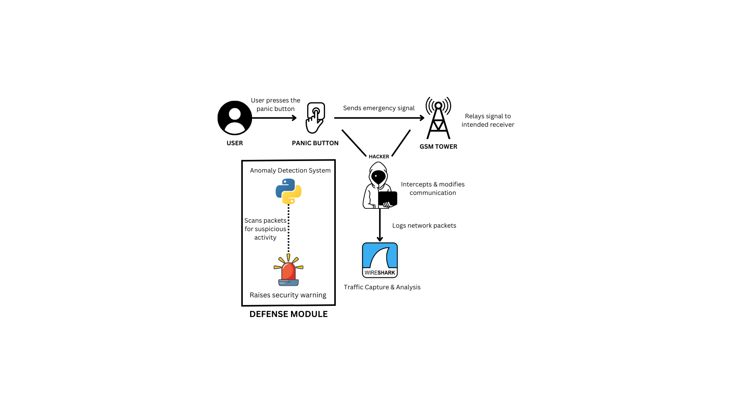
DEPARTMENT OF COMPUTER SCIENCE AND ENGINEERING
ARCHITECTURE DIAGRAM
MAN-IN-THE-MIDDLE ATTACK ON PANIC BUTTONS OPERATING IN GSM NETWORKS:
04

Slide 11
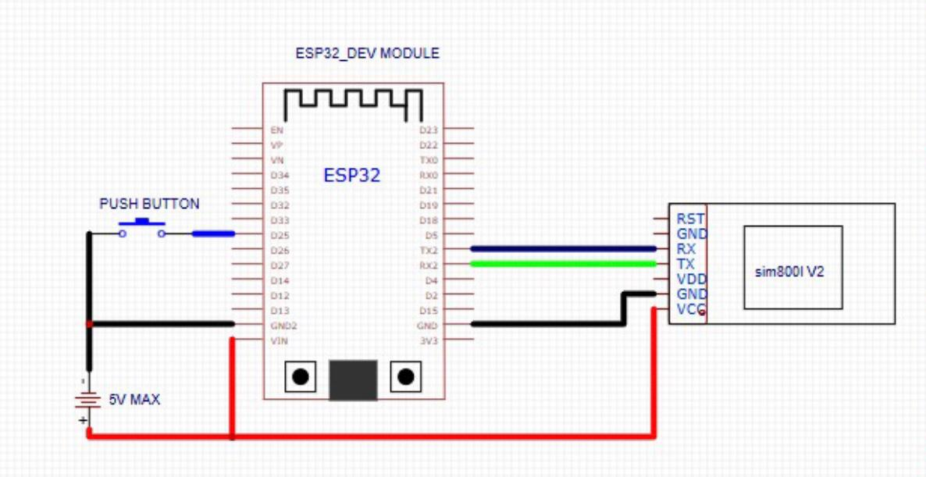
DEPARTMENT OF COMPUTER SCIENCE AND ENGINEERING
CIRCUIT DIAGRAM
MAN-IN-THE-MIDDLE ATTACK ON PANIC BUTTONS OPERATING IN GSM NETWORKS:
04

Slide 12
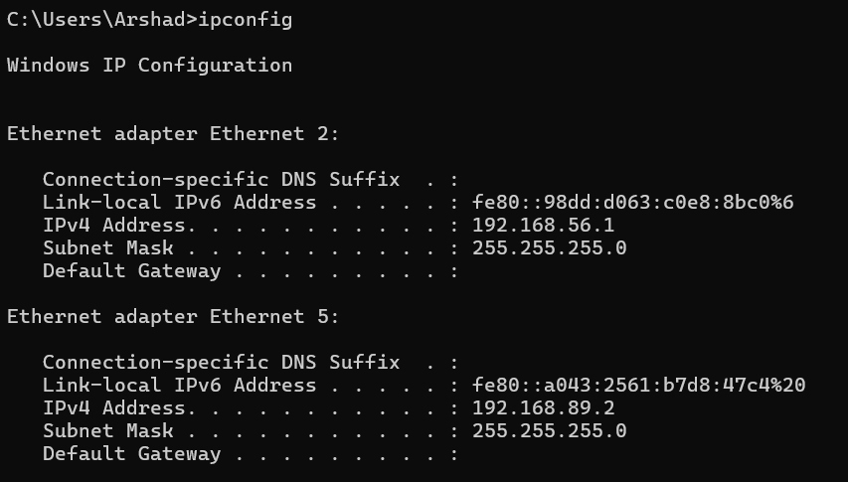

DEPARTMENT OF COMPUTER SCIENCE AND ENGINEERING
IMPLEMENTATION
MAN-IN-THE-MIDDLE ATTACK ON PANIC BUTTONS OPERATING IN GSM NETWORKS:
04

Slide 13
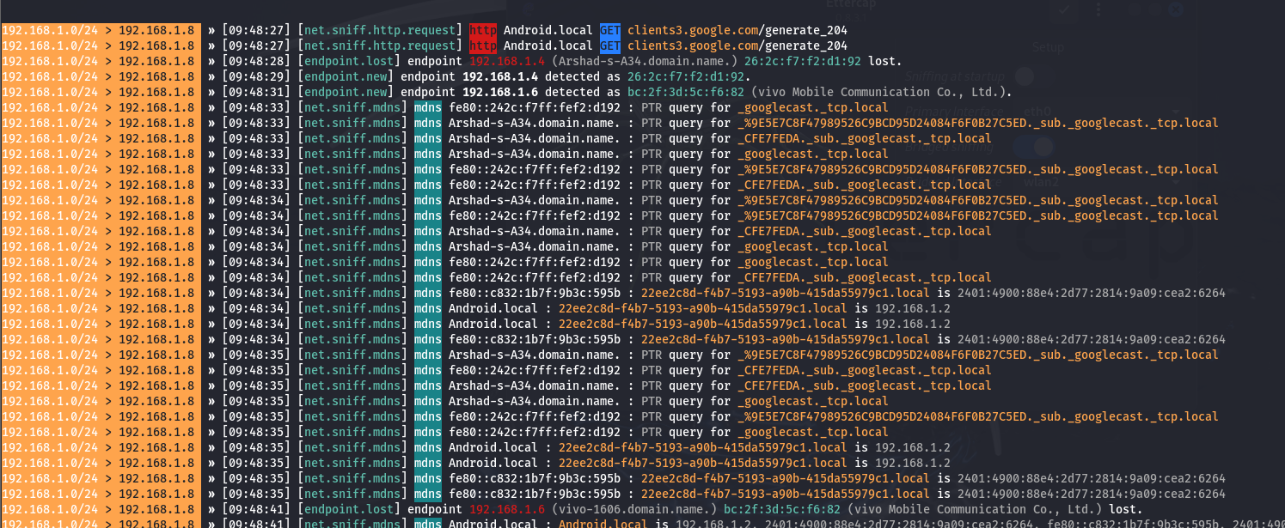
DEPARTMENT OF COMPUTER SCIENCE AND ENGINEERING
IMPLEMENTATION
MAN-IN-THE-MIDDLE ATTACK ON PANIC BUTTONS OPERATING IN GSM NETWORKS:
04

Slide 14
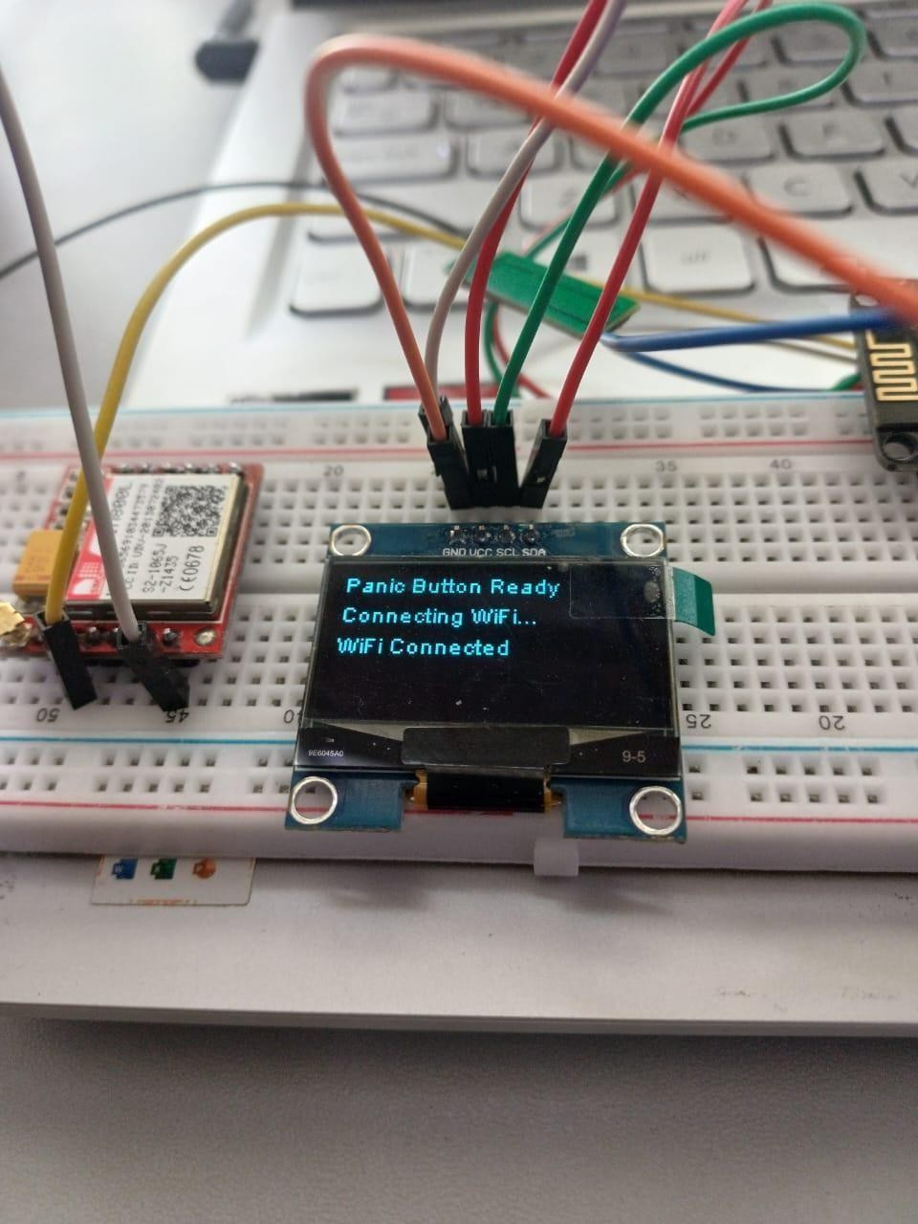
DEPARTMENT OF COMPUTER SCIENCE AND ENGINEERING
IMPLEMENTATION
MAN-IN-THE-MIDDLE ATTACK ON PANIC BUTTONS OPERATING IN GSM NETWORKS:
04

Slide 15
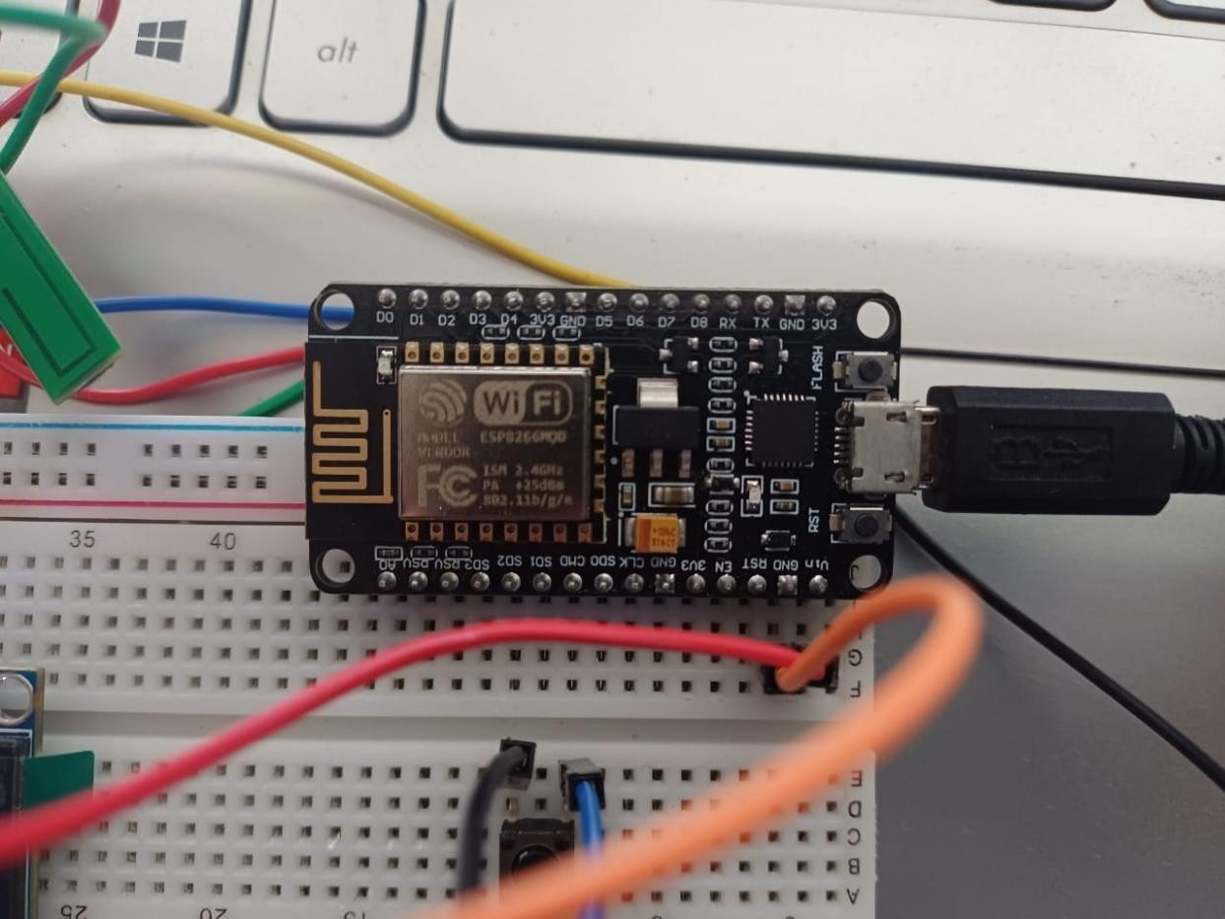
DEPARTMENT OF COMPUTER SCIENCE AND ENGINEERING
IMPLEMENTATION
MAN-IN-THE-MIDDLE ATTACK ON PANIC BUTTONS OPERATING IN GSM NETWORKS:
04

Slide 16
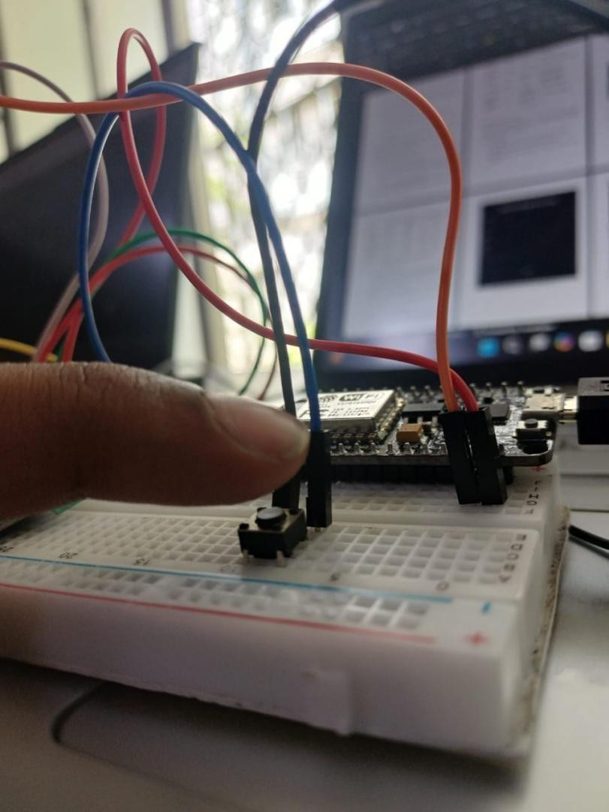
DEPARTMENT OF COMPUTER SCIENCE AND ENGINEERING
IMPLEMENTATION
MAN-IN-THE-MIDDLE ATTACK ON PANIC BUTTONS OPERATING IN GSM NETWORKS:
04

Slide 17
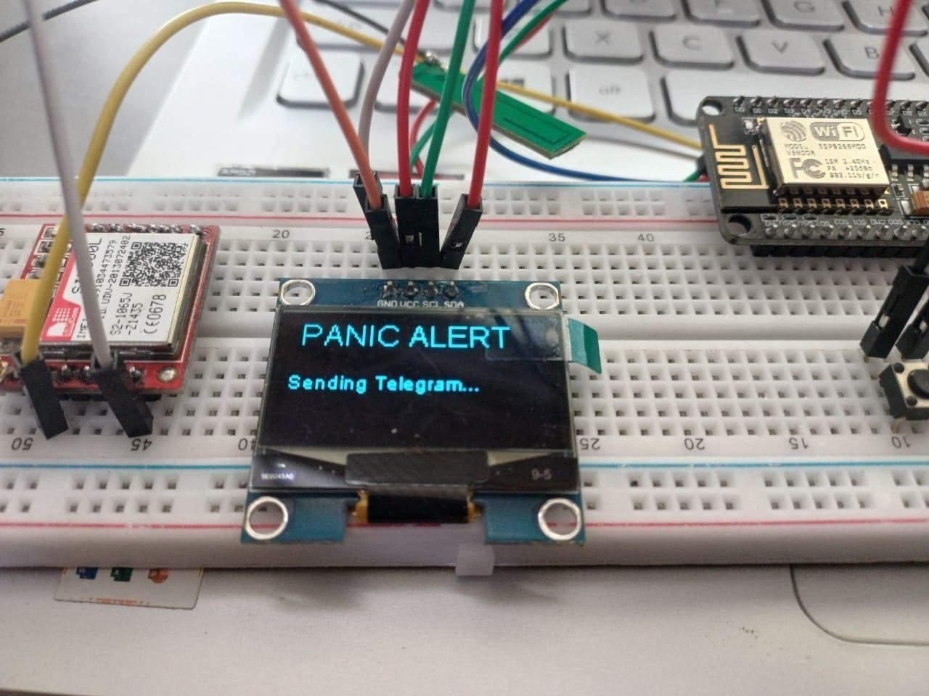
DEPARTMENT OF COMPUTER SCIENCE AND ENGINEERING
IMPLEMENTATION
MAN-IN-THE-MIDDLE ATTACK ON PANIC BUTTONS OPERATING IN GSM NETWORKS:
04

Slide 18
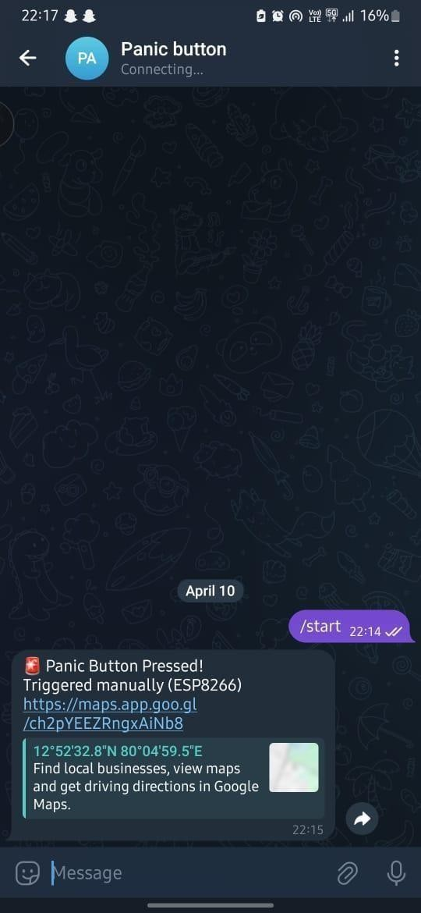
DEPARTMENT OF COMPUTER SCIENCE AND ENGINEERING
IMPLEMENTATION
MAN-IN-THE-MIDDLE ATTACK ON PANIC BUTTONS OPERATING IN GSM NETWORKS:
04

Slide 19
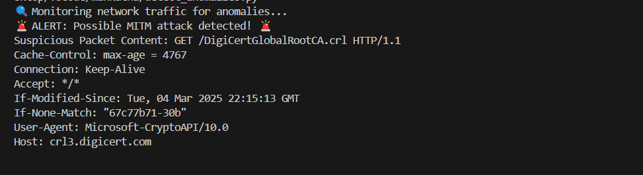
DEPARTMENT OF COMPUTER SCIENCE AND ENGINEERING
IMPLEMENTATION
MAN-IN-THE-MIDDLE ATTACK ON PANIC BUTTONS OPERATING IN GSM NETWORKS:
04

Slide 20
DEPARTMENT OF COMPUTER SCIENCE AND ENGINEERING
REFERENCE WORK
Muteeb Bin Muzammil, Muhammad Bilal, Sahar Ajmal, Sandile C. Shongwe, And Yazeed Y. Ghadi, "Unveiling Vulnerabilities of Web Attacks: Considering Man in the Middle Attack and Session Hijacking", IEEE, 2023.
Multiple authors, "Penetration Testing of GSM Network using MAN-IN-THE-MIDDLE Attack", EKB Journal, 2023.
Ahmed M. Fahad, Abdulghani Ali Ahmed, Mohd Nizam Mohmad Kahar, "Preventing MAN-IN-THE-MIDDLE (MITM) Attack of GSM Calls", ScienceGate, 2022.
Albert & Indra, "A Review of Security Attacks and Solutions for GSM Communication Systems", EJECE, European Journal of Electrical Engineering and Computer Science, ResearchGate, 2021.
MAN-IN-THE-MIDDLE ATTACK ON PANIC BUTTONS OPERATING IN GSM NETWORKS:
08

Slide 21
DEPARTMENT OF COMPUTER SCIENCE AND ENGINEERING
REFERENCE WORK
5. Lin, Wang, and Li, "Analysis of GSM Call Vulnerabilities: Case Studies in MAN-IN-THE-MIDDLE Attacks", 2021.
6. Singh et al., "Security Flaws in GSM Networks and Suggested Cryptographic Enhancements", 2023.
7. Patel and Singh, "Machine Learning Approaches for Detecting MAN-IN-THE-MIDDLE Attacks in GSM Systems", 2024.
MAN-IN-THE-MIDDLE ATTACK ON PANIC BUTTONS OPERATING IN GSM NETWORKS:
09

